Slide 1
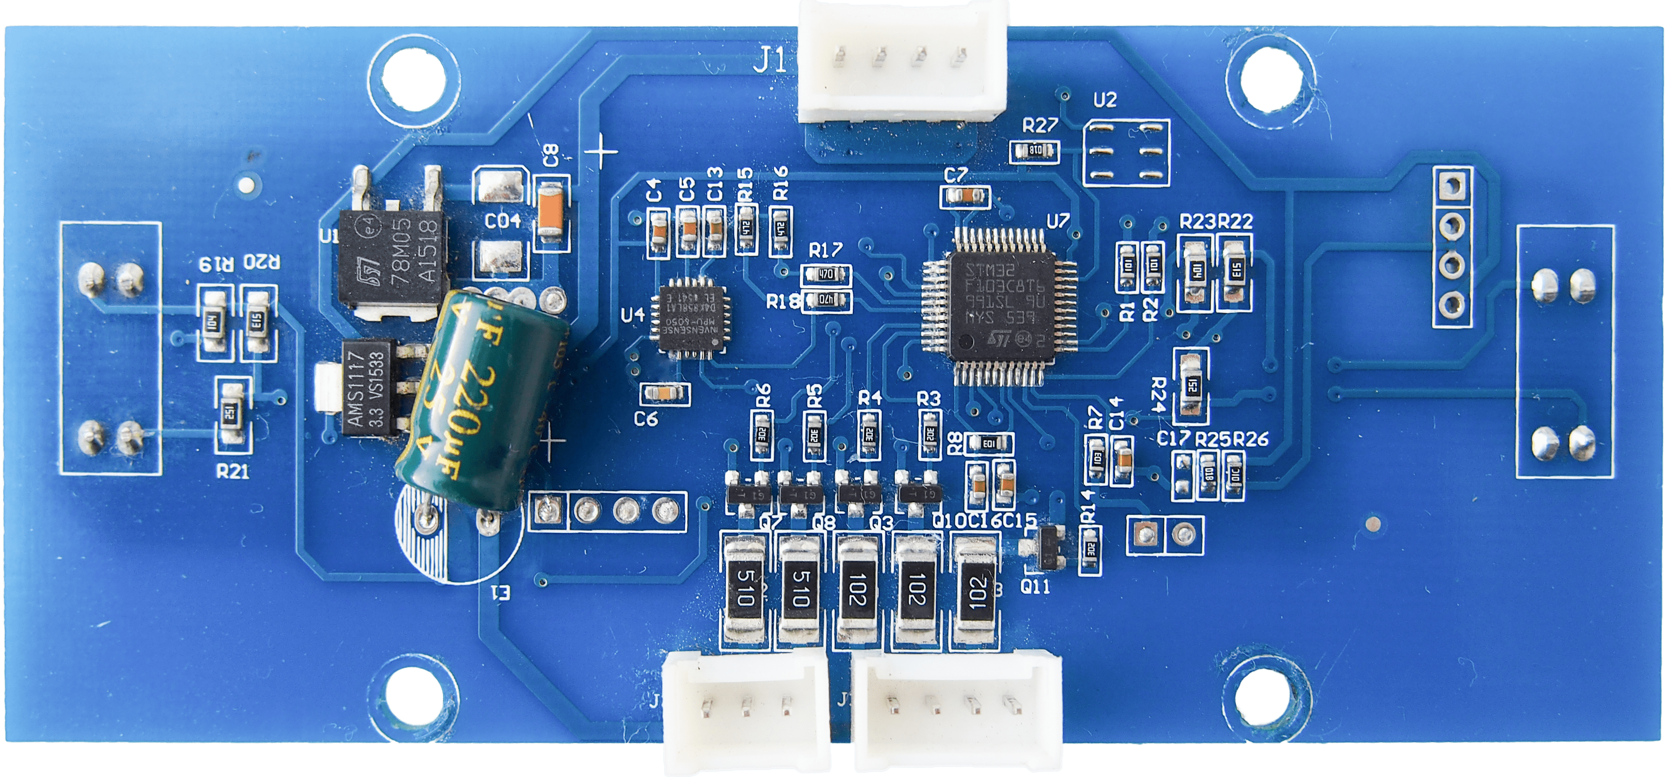
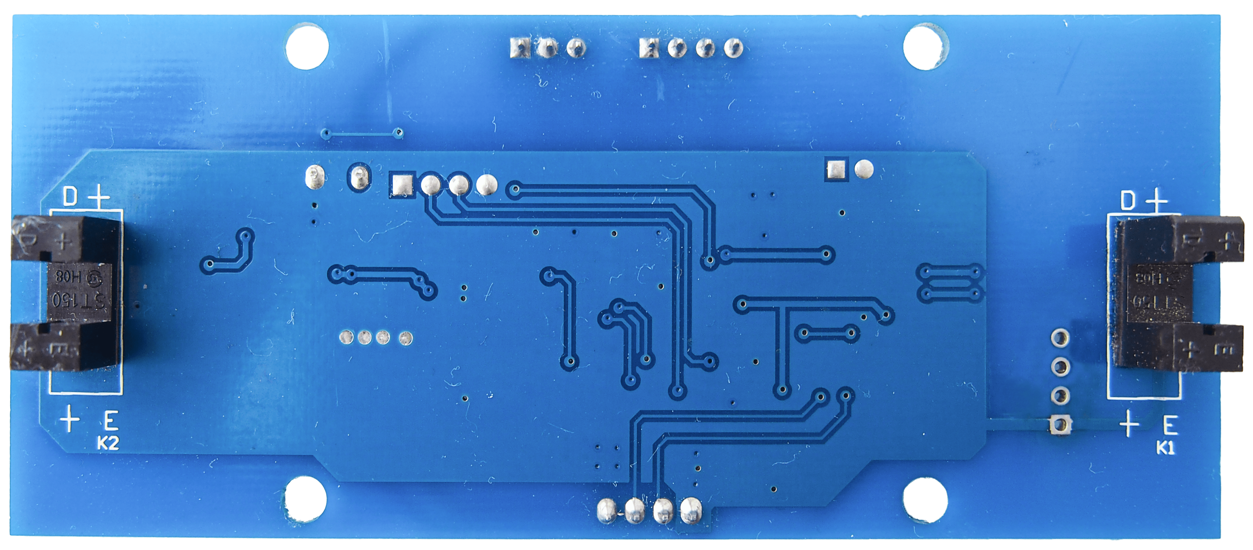
IMU MPU-6050
PB6 / MPU_SCL
Main Board
GND
PA2 / TX
PA3 / RX
PB7 / MPU_SDA
VDD 15V
PB11 / AUX3_PU
RF Module HFY-J18
(optional)
GND
PC15 / AUX1_PU
PC15 / AUX1_PU
VDD 5V
PC14 / SENSOR2
PA4 / SENSOR1
GND
PA1 / AUX2
LED Boards
PA0 / LED1
PB9 / LED2
PB8 / LED3
PB5 / LED4
VDD 15V
PB4 / LED5
SWD Programming
VDD 15V
PA13 / SWDIO
GND
PA14 / SWCLK
VDD 3.3V

Slide 2
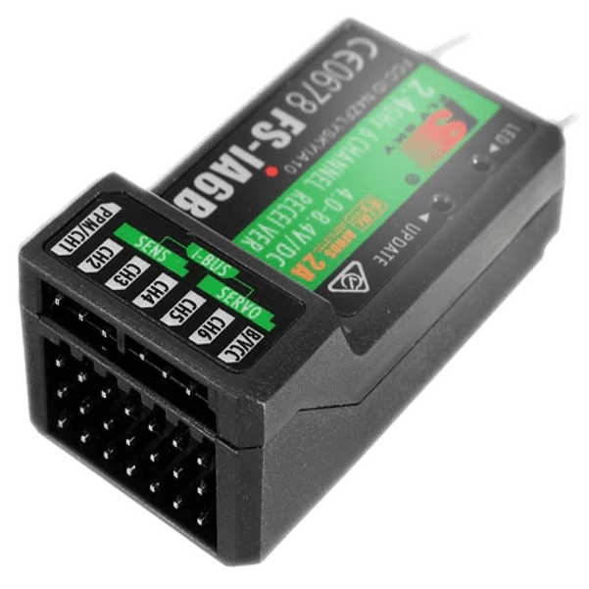

100 ohm (recommended)
FS-iA6B
GND
VDD 5V
PA10 / AUX_RX

